Slide 1
LORENZ SYSTEM
21PHE0011

Slide 2
Defining Chaos
Chaos is aperiodic long-term behaviour in a deterministic system that exhibits sensitive dependence on initial conditions
Aperiodic long-term behaviour means that there are trajectories which do not settle down to fixed points, periodic or quasi periodic orbits as t → ∞.
Deterministic means that the system has no random or noisy inputs or parameters. Irregular behaviour arises solely from the system’s nonlinearity.
Sensitive dependence on initial conditions means that nearby trajectories diverge exponentially fast.

Slide 3
The Lorenz (1963) Equations
The Lorenz equations were originally derived by Saltzman (1962) as a ‘minimalist’ model of thermal convection in a box.
x˙ = σ(y − x)
y˙ = rx − y − xz
z˙ = xy − bz
where σ (“Prandtl number”), r (“Rayleigh number”) and b are parameters (> 0).
d/dt (X) = f(X,t,b)
Β =[σ r b ]^{T}
X =[x y z]^{T}

Slide 4
Simple properties of the Lorenz Equations
Nonlinearity - the two nonlinearities are xy and xz •
Symmetry - Equations are invariant under (x, y) → (−x, −y). Hence if (x(t), y(t), z(t)) is a solution, so is (−x(t), −y(t), z(t))
Volume contraction - The Lorenz system is dissipative i.e. volumes in phase-space contract under the flow.
Fixed points - (x ∗ , y ∗ , z ∗) = (0, 0, 0) is a fixed point for all values of the parameters

Slide 5
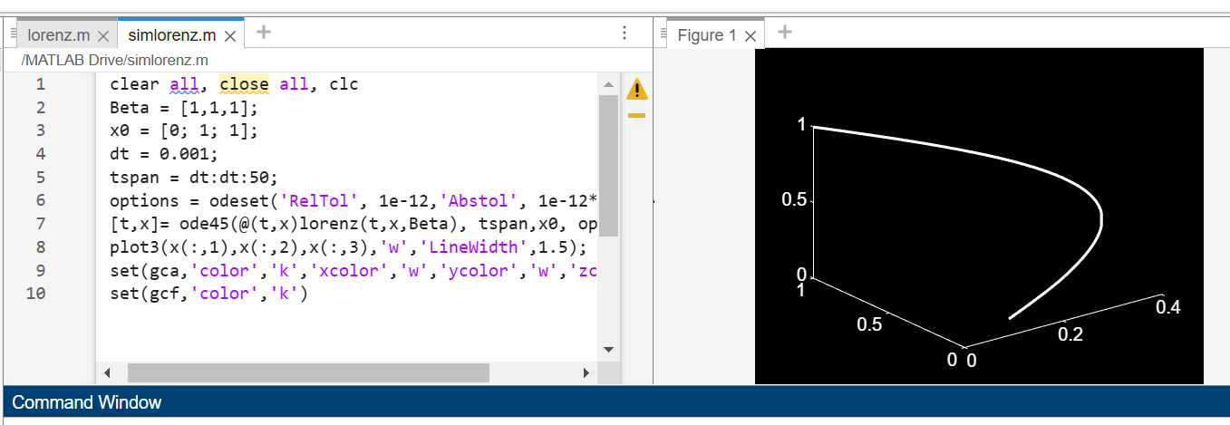
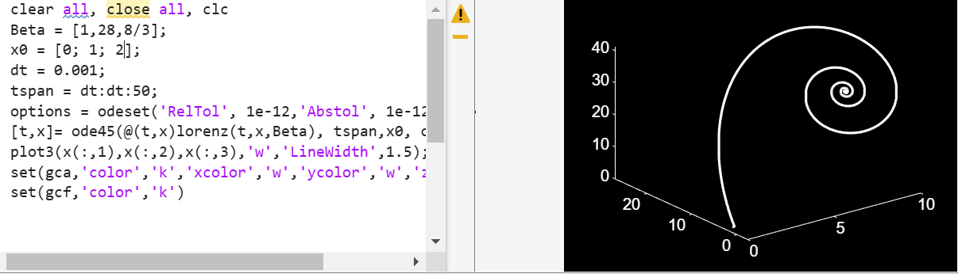
SIMULATIONS

Slide 6
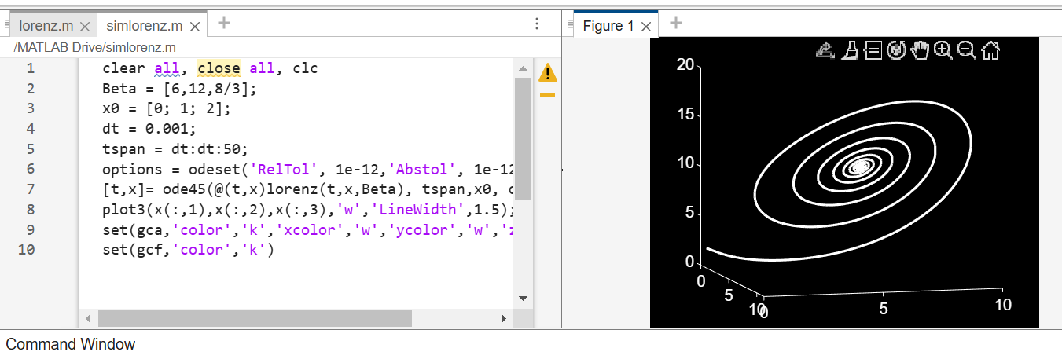
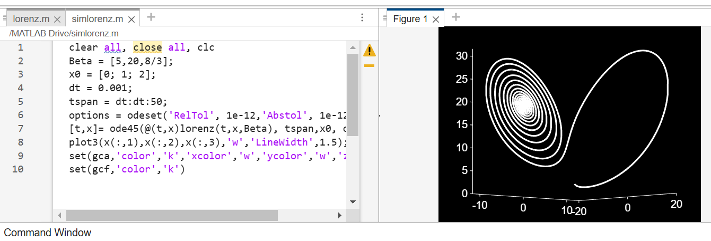

Slide 7
